Slide 1
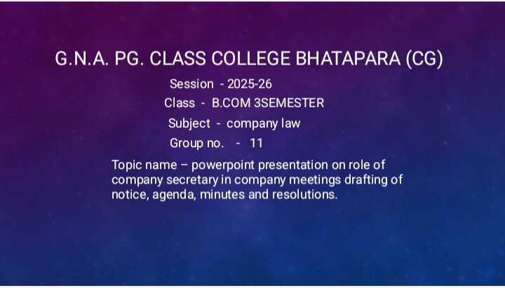

Slide 2


Slide 3


Role of Company Secretary
The company secretary plays a vital role in facilitating company meetings by preparing essential documents such as notices, agendas, minutes, and resolutions. This presentation delves into these fundamental responsibilities, aiming to enhance understanding and ensure compliance within the organization.

Slide 4


Importance of Company Secretary
Legal Compliance
Ensures legal compliance during meetings, safeguarding stakeholder interests.
Communication Link
Acts as the main communication link between the board and stakeholders.
Meeting Organization
Organizes meetings to foster effective decision-making and strategy discussions.

Slide 5




Drafting Meeting Notices
2
Timely Distribution
Send notices within a specified timeframe.
Drafting Requirements
1
Must include timing, location, and purpose.
Legal Protection
Helps mitigate legal risks and ensures compliance.
3

Slide 6






Preparing Agendas
1
Purpose of Agendas
Agendas outline the topics to be discussed during the meeting and help keep discussions focused and productive.
2
Collaboration for Prioritization
The company secretary collaborates closely with the chairperson to prioritize agenda items, ensuring the inclusion of vital topics relevant to stakeholders.
3
Benefits of a Well-Structured Agenda
A well-structured agenda aids in time management and can enhance participation by providing clarity on expected outcomes.

Slide 7



Recording Minutes of Meetings
Accurate Recording
Recording minutes accurately is vital for reflecting discussions and decisions.
Secretary's Responsibility
The company secretary ensures minutes are clear and concise.
Timely Distribution
Minutes should be shared promptly for review and approval.

Slide 8



Drafting Resolutions
Legal Understanding
Drafting requires a clear understanding of legal and regulatory language.
2
Formal Decisions
Resolutions are formal decisions made by the board or shareholders.
1
Approval and Documentation
3
Ensure all necessary approvals are obtained and decisions are recorded.

Slide 9


Legal Compliance and Governance
Stay Updated
Advise the Board
Reduce Risks
Company secretaries must stay updated on relevant laws and regulations.
They advise the board on governance matters and ethical standards.
Involvement in legal compliance reduces risks and enhances reputation.

Slide 10







Communication with Stakeholders
1
Manage Communication
Company secretaries manage communication with shareholders and other stakeholders.
2
Address Inquiries
This role includes addressing inquiries and concerns from stakeholders.
3
Improve Engagement
Effective communication strategies improve stakeholder engagement.

Slide 11





Challenges Faced by Company Secretaries
Stakeholder Expectations
Board Conflicts
Managing diverse expectations from stakeholders.
Navigating conflicts and differing opinions within the board.
Continuous Development
Regulatory Changes
Ensuring ongoing professional growth and skill enhancement.
Keeping up with shifts in regulations.
2
3
1
4

Slide 12



Best Practices for Efficiency
Utilize Technology
Streamline processes, saving time and reducing errors.
Establish Protocols
Ensure all necessary materials are ready and accessible.
Regular Training
Improve performance of the company secretary and optimize contribution.

Slide 13


Role of Company Secretary in Corporate Governance
The company secretary plays a fundamental role in facilitating effective company meetings. Their responsibilities are vital for ensuring compliance, promoting good governance, and fostering positive stakeholder relationships. An effective company secretary significantly contributes to the overall success of corporate governance frameworks.
Facilitating Meetings
Ensuring Compliance
Fostering Relationships
Drafting notices, agendas, minutes, and resolutions.
Vital for promoting good governance.
Building positive stakeholder relationships.

Slide 14
Corporate Governance References
2
Best Practices
Best practices in corporate governance literature.
Legal Guidelines
Legal guidelines governing company meetings and resolutions.
1
Communication Strategies
Resources on effective communication strategies in corporate settings.
3

Slide 15






Future Trends in Corporate Governance
1
Digital Tool Adoption
The increasing adoption of digital tools will continue to transform the role of company secretaries, making their work more efficient.
2
Corporate Social Responsibility
Growing emphasis on corporate social responsibility may influence the nature of discussions and decisions made in meetings.
3
Stakeholder Engagement
Enhanced stakeholder engagement strategies will be essential for company secretaries in maintaining transparency and accountability within organizations.

Slide 16






Questions & Discussion on Company Secretaries
1
2
3
Open Floor for Questions
Different Organizational Approaches
Best Practices in Handling Challenges
Engage in a discussion about company secretaries' roles in meetings.
Examine various methods organizations use regarding company secretary responsibilities.
Identify effective strategies for overcoming challenges faced by company secretaries.

